Slide 1
Modern Control Theory
Model Predict Control - MPC – Lecture 7
Dynamic Prediction Models

Slide 2


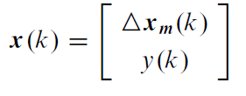
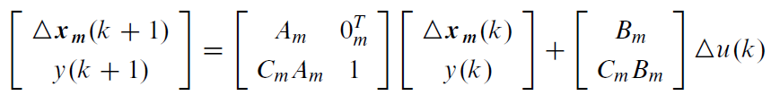

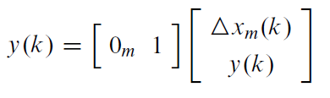
Prediction using State space models (5/6)
System in incremental form
Difference in outputs
Define
We get
y(k) = C x(k)

Slide 3
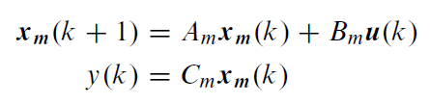
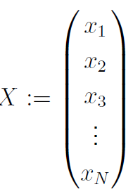
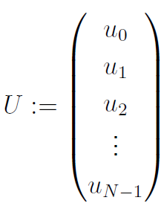
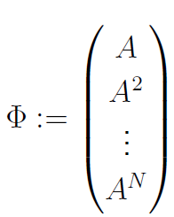
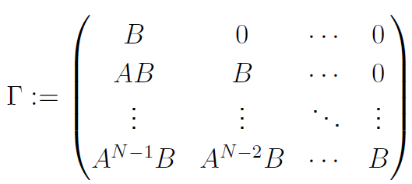
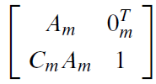
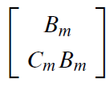

Prediction using State space models (6/6)
System
representation
System in incremental form
y(k) = C x(k)
State Prediction equation
X(k+1) = Φ x₀ + ΤΔU(k)
A =
B =
C =
Y(k) = CΧ(k)
Output Prediction equation

Slide 4


Prediction equation comparison
State space prediction equation
X(k+1) = Φ x₀ + ΤΔU(k)
Y(k+1) = CΧ(k+1)
State space Output Prediction equation
Step response Prediction equation
Free response =
C Φ x₀ =
Forced response =
CΤΔU(k) =

Slide 5
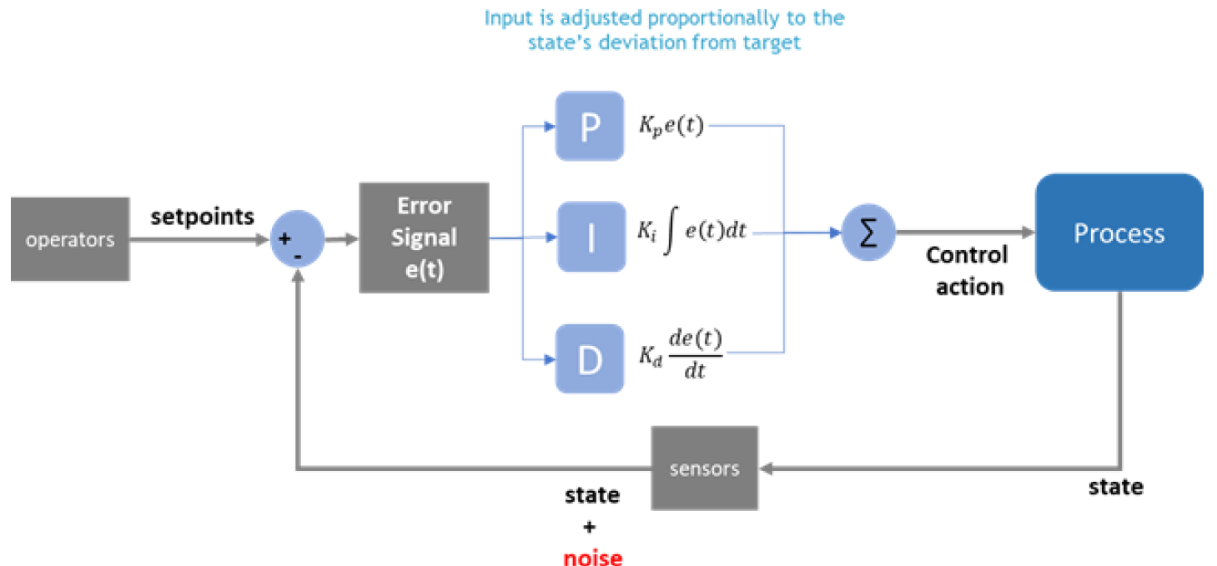
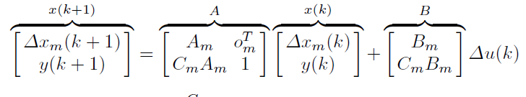
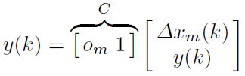


Importance of Integrators – offset free control
Classical Feedback control
Steady error of closed loop system goes to zero if the
Controller has an integral action or
plant already has integral action
Eigen matrix of A
= (λ-1)*det(λI-A_{m}) = (λ-1)*Eigen(A_{m})
The delta model add at least one integrator to the original open loop system
For MIMO the system , the integrators would be as many outputs

Slide 6
State space model – need of observer
For prediction propagation, what can we say about the state measurements?
State space model assumes the all states are measurable
If only few measurements exist, how would be propagate the states?
The answer is Observer
The observer allows us to estimate the states from the measurements
(Cm, Am) are observable pair

Slide 7








Observer re-cap
Let
denote the estimates of x_{m}(k) given
Estimated system
Actual system
Define
This is open loop prediction with standard pitfalls:
Works only if initial condition is accurate
Convergence is not guaranteed

Slide 8



How do we design observer
Use measurement feedback to address the pitfalls
Original model propagation
Correction term
With initial error in X_{m}(0)
CLOSED LOOP POLE placement to get the error to zero with a proper design of K_{ob}
K_{ob} gives degrees of freedom

Slide 9
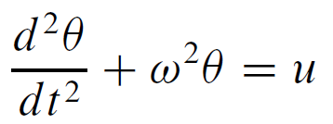

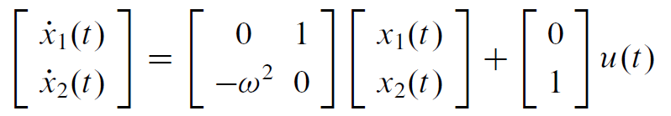
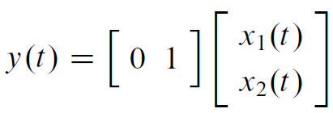
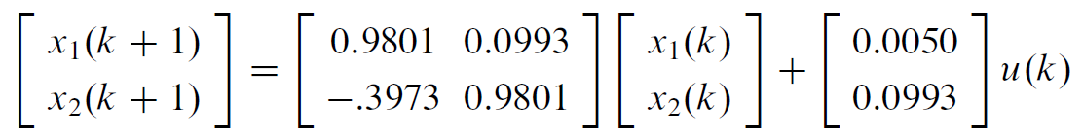
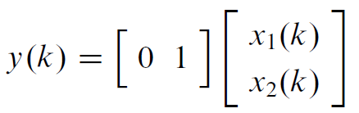
Example – SISO observer
Simple pendulum – linearized equation of motion
Measurement is angular velocity – dθ/dt
Estimate pendulum angle θ
Let ω = 2 rad/s, sampling interval = 0.1 sec
States:
(dθ/dt)
Model
Discrete model:

Slide 10
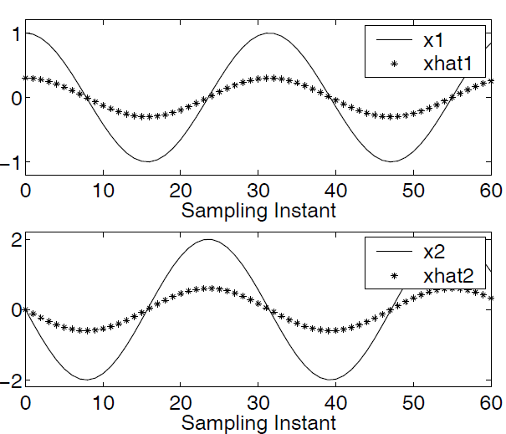
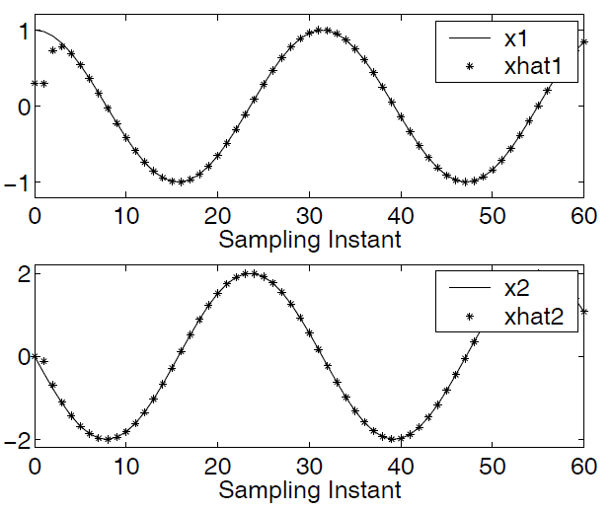
Example – SISO observer
System initial condition
θ (0) = x₁(0) = 1, x₂(0) = 0
Observer initial condition
observer with closed loop poles 0.1 and 0.2
Open loop observer with K_{ob} = 0

Slide 11
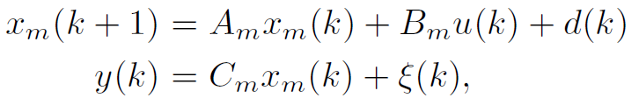
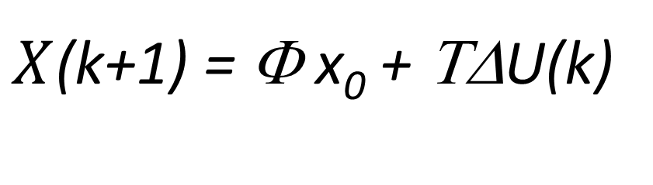
MIMO system – Kalman filter
Real life, state and measurements have noise
Propagation of noise must be handled properly
d(k) = state noise
ξ(k) = measurement noise
$X$(k+1) = Φ x₀ + ΤΔU(k)
Prediction will be using the estimated state

Slide 12
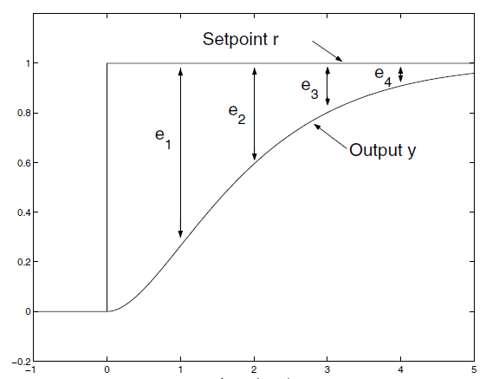
Cost function
Minimize the error between set-point and predicted response at all steps
This leads faster response
Minimize the control that minimized the error between set-point and predicted response at all steps
This leads trade off between faster response and use of input energy

Slide 13
Zone
Trajectory
Funnel

